Slide 1
The Limits to Growth: Sustainability and the Circular Economy
Lecture 5: Circular Economy
Prof. Dr. Benjamin Leiding
M.Sc. Anant Sujatanagarjuna
M.Sc. Chintan Patel

Slide 2
License
This work is licensed under a Creative Commons Attribution-ShareAlike 4.0 International License. To view a copy of this license, please refer to https://creativecommons.org/licenses/by-sa/4.0/ .
Updated versions of these slides will be available in our Github repository.

Slide 3
Introduction

Slide 4
Introduction
Sustainability – Definition
„Development that meets the needs of the present without compromising the ability of future generations to meet their own needs.”
Report of the World Commission on Environment and Development: Our Common Future (1987) – http://www.un-documents.net/our-common-future.pdf

Slide 5
Introduction
Sustainability – Implications
Sustainability → Consume less

Slide 6
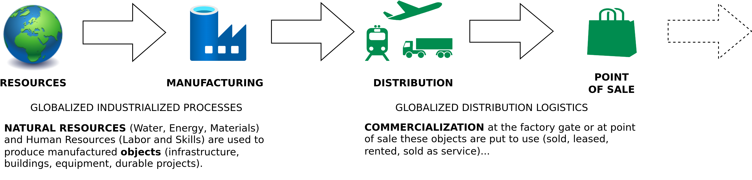
Introduction
Linear (Industrial) Economy
Image adapted from: Walter R. Stahel (2019) – The Circular Economy: A User’s Guide.

Slide 7
Introduction
Linear Economy
“Take – Make – Dispose”

Slide 8
Introduction
Linear Economy
“Take – Make – Dispose”

Slide 9
Introduction
Linear (Industrial) Economy – Definition
“Its objectives are to maintain value (not to create value added), to optimise stock management (not flows) and to increase the efficiency of using goods (not of producing goods)”
Walter R. Stahel (2019) – The Circular Economy: A User’s Guide.

Slide 10
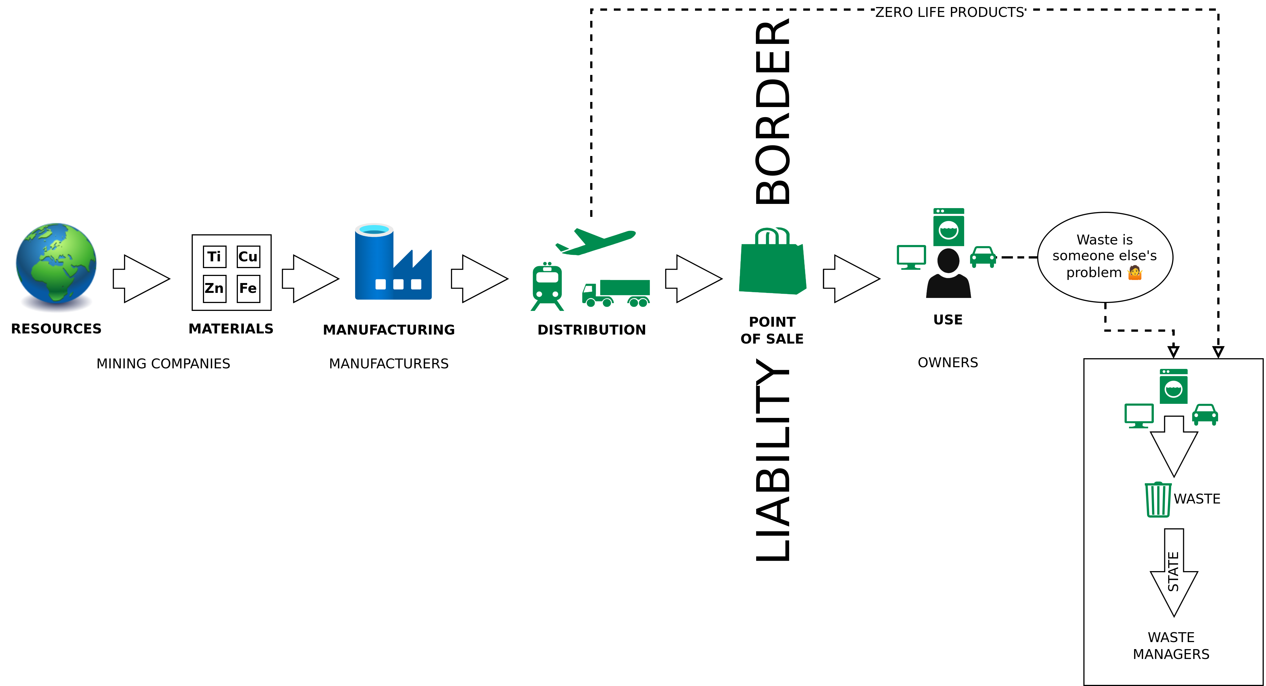
Introduction
Linear (Industrial) Economy – Waste Management as last Step
Image adapted from: Walter R. Stahel (2019) – The Circular Economy: A User’s Guide.

Slide 11
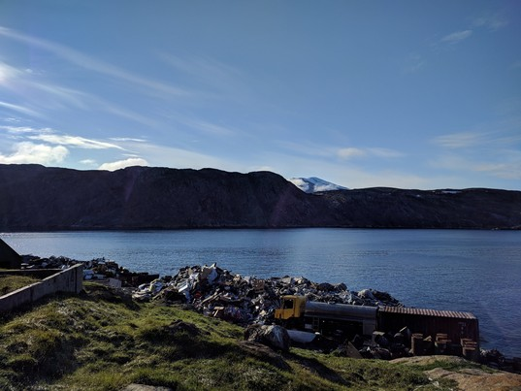
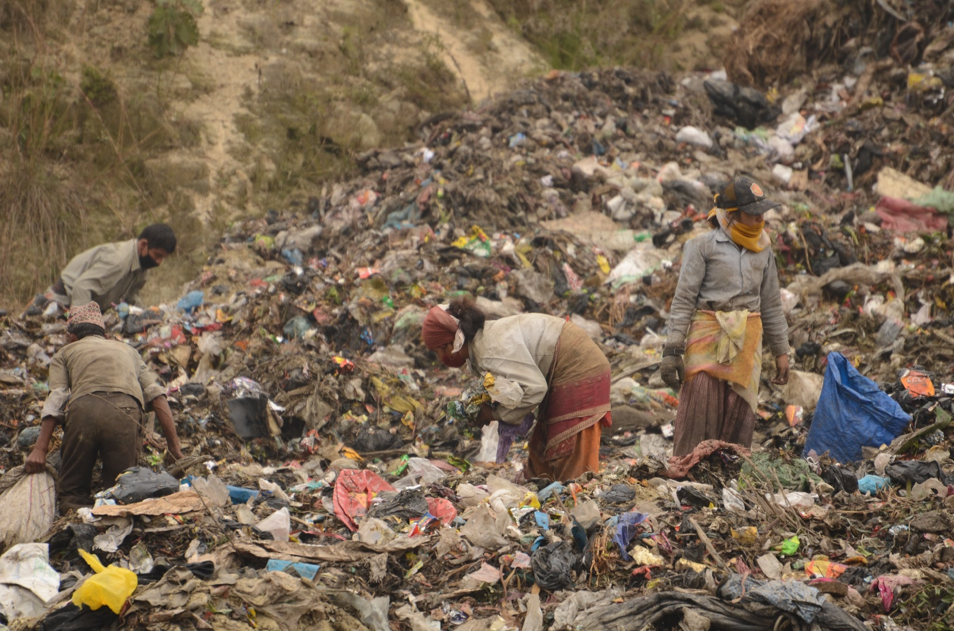
Introduction
Horrible Waste Management
1. "Landfill at Upernavik" by ulalume – https://www.flickr.com/photos/96649248@N00/43867280734 – CC BY-NC-ND 2.0.
2. Christian Hüpfer – https://flic.kr/p/aKXw2F – CC BY-SA 2.0.

Slide 12
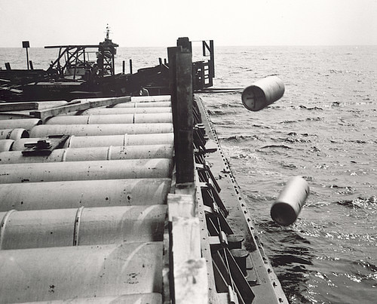
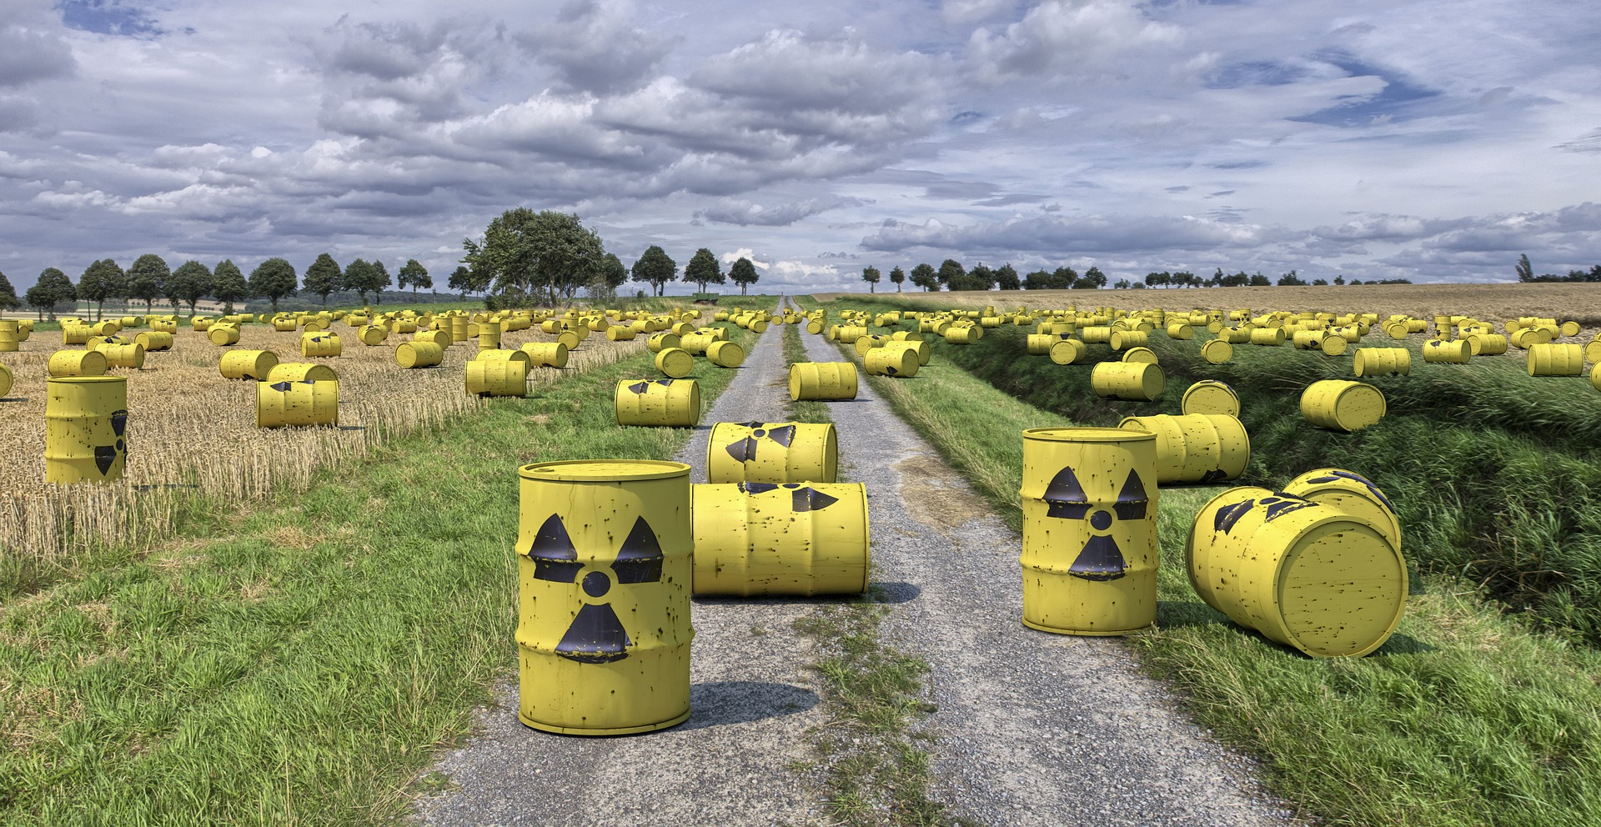
Introduction
Horrible Waste Management – Nuclear Waste
"Nuclear waste" by aaadrian365 is licensed with CC BY-NC 2.0. To view a copy of this license, visit https://creativecommons.org/licenses/by-nc/2.0/

Slide 13
Introduction
Horrible Waste Management – Nuclear Waste
→ 40,000 generations will have to live with the waste
→ 2 generations profited from cheap nuclear energy
→ 40,000 generation will have to live with the waste
https://www.spiegel.de/wissenschaft/technik/endlager-suche-was-wie-viel-und-wohin-damit-die-deutsche-atommuell-bilanz-a-7a153ba3-029a-4e55-adaf-3312b7427d9e

Slide 14
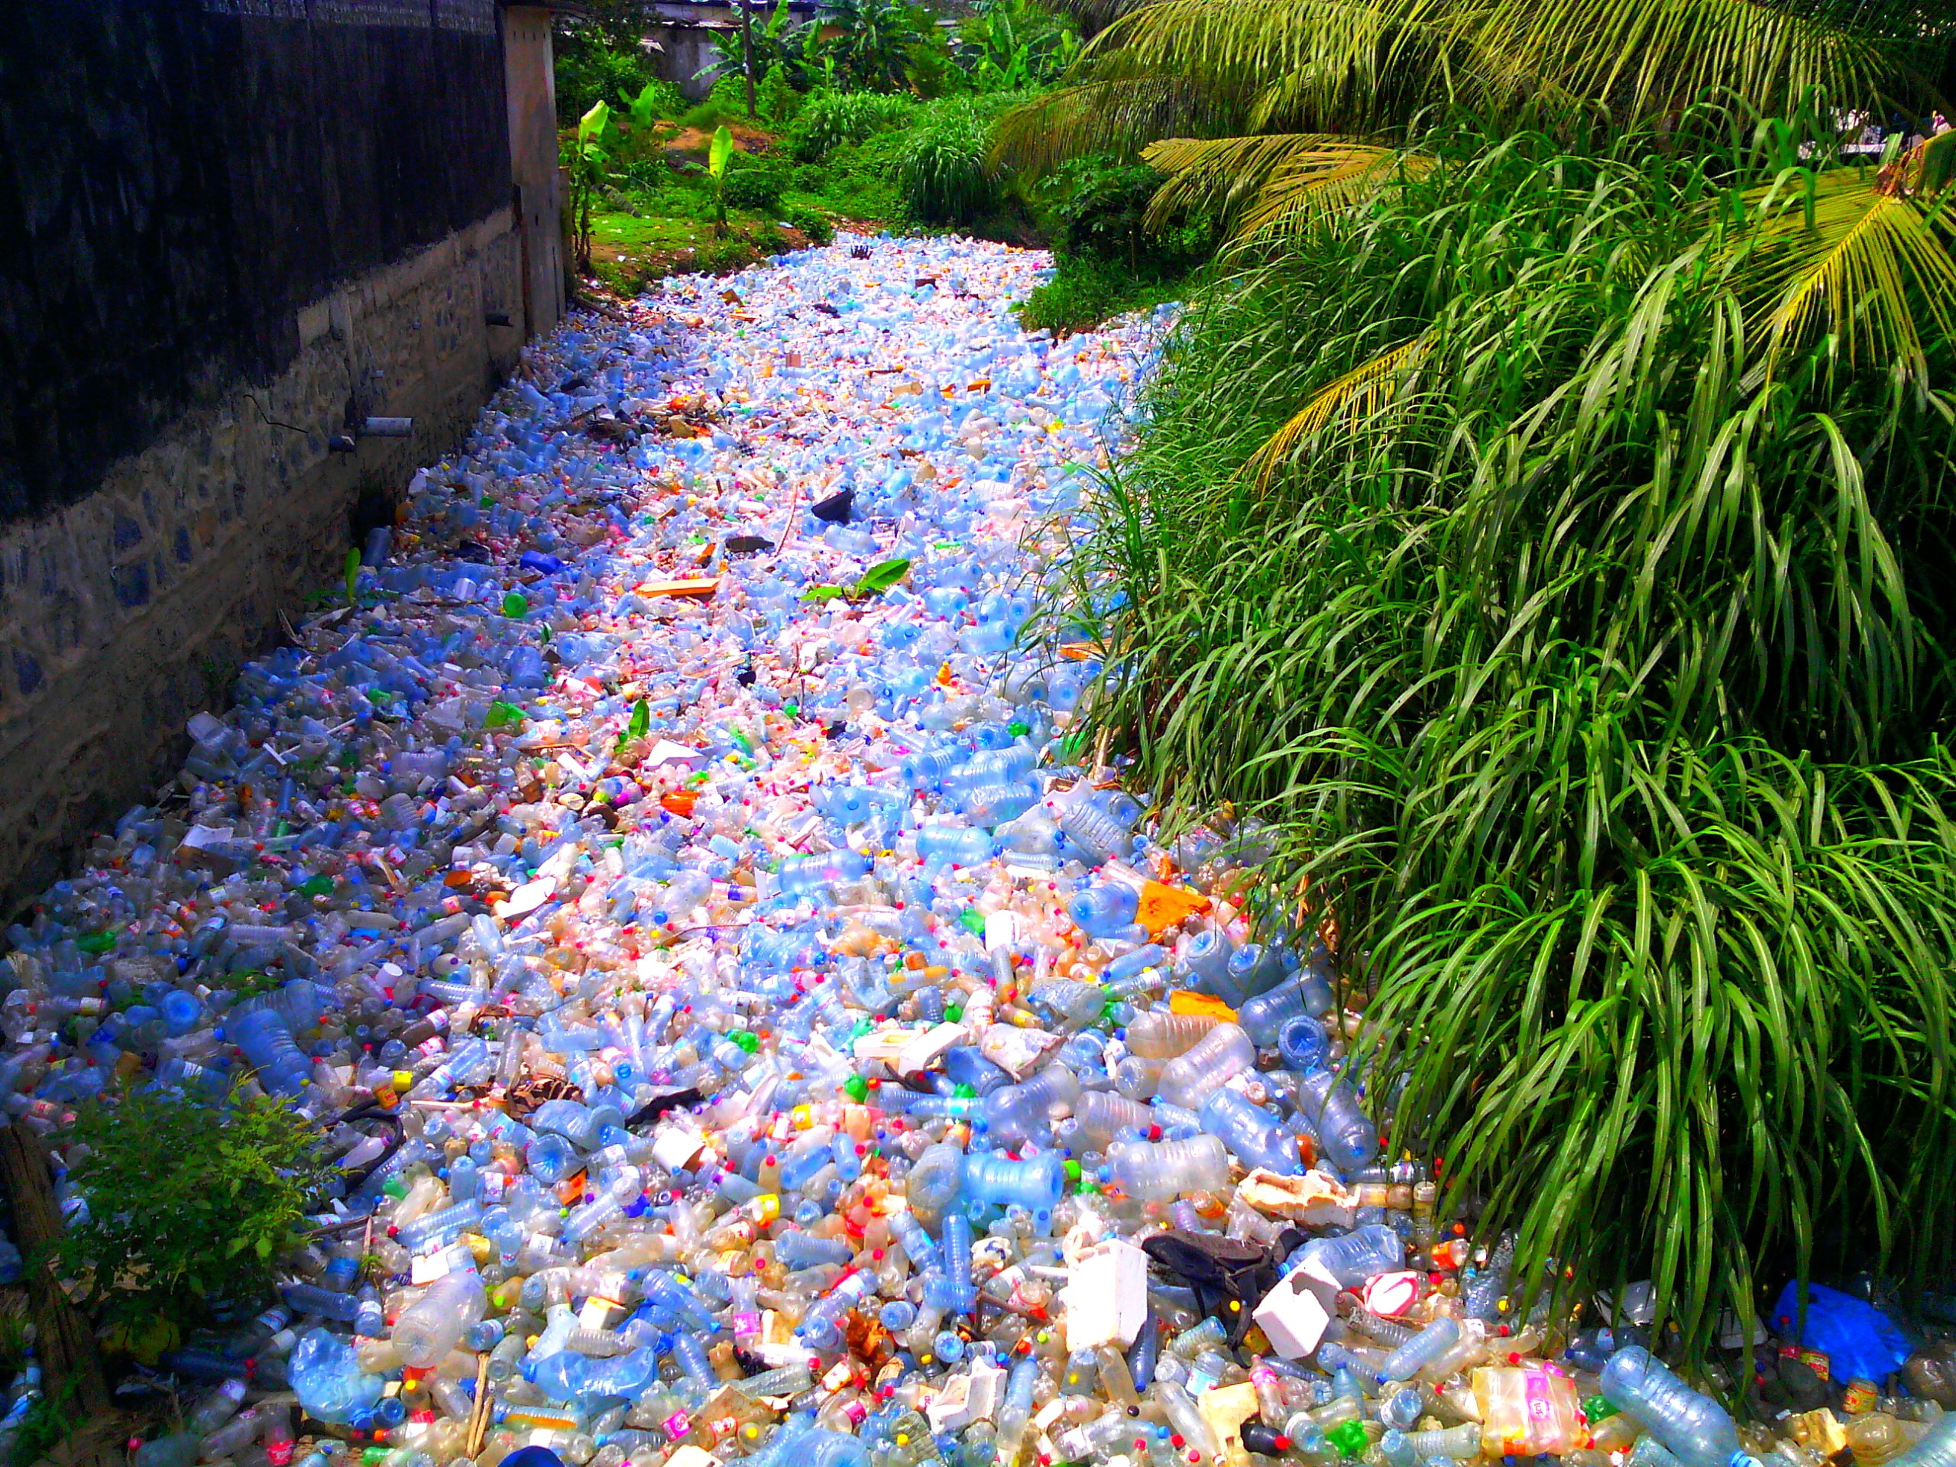
Introduction
Horrible Waste Management – Plastic
"Pollution Plastique" by Mouenthias is licensed with CC BY-SA 4.0. To view a copy of this license, visit https://creativecommons.org/licenses/by-sa/4.0/

Slide 15
Introduction
The Limits to Recycling
Recycling often requires a lot of energy
Some materials cannot be recycled at all (yet)
Impurities are challenging
Often requires a lot of manual labor
Recycled material often with lower quality than input material
False sense of safety!
I am not saying you should stop recycling!
→ Recycling is great but it is better to make sure that we do not have to recycle anything.
→ Buying less (e.g., only the essentials) is way more effective.
“We buy things we don't need, to impress people we don't like.” - Tyler Durden / Chuck Palahniuk

Slide 16
Waste = Inefficiency

Slide 17
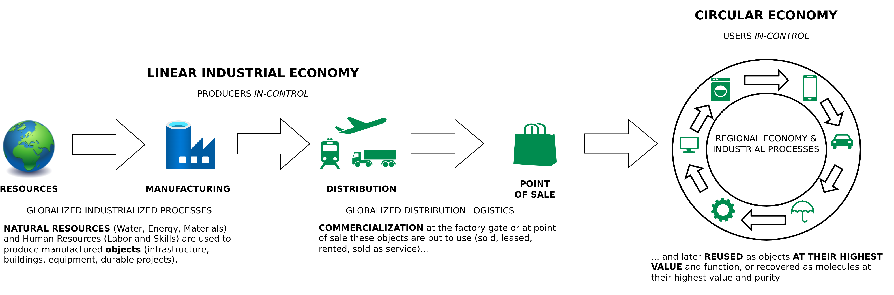
Introduction
From Linear to Circular
Image adapted from: Walter R. Stahel (2019) – The Circular Economy: A User’s Guide.

Slide 18
Introduction
Linear Economy – Main Challenges
Environmental pollution / waste
Waste of resources
→ Just recycling is not gonna do it
Therefore:
Consume less
Make stuff last longer
Maximize resource utilization

Slide 19
Introduction
Linear Economy – Main Challenges
Environmental pollution / waste
Waste of resources
→ Just recycling is not gonna do it
Therefore:
Consume less
Make stuff last longer
Maximize resource utilization

Slide 20
The Circular economy

Slide 21
Circular Economy
Center for Digital Technologies (DIGIT) (2022) – https://www.digit-research.de/fileadmin/DIGIT/Presse_und_News/Downloads/Grafikpaket_Reallabor_DCE_Kreislaufmodell_V2_ccby.zip – CC BY 4.0.

Slide 22
Circular Economy
Definition
“Conceptualizing the circular economy: An analysis of 114 definitions.”
Kirchherr, Julian, Denise Reike and Marko P. Hekkert. Resources Conservation and Recycling 127 (2017): 221-232.
https://doi.org/10.1016/J.RESCONREC.2017.09.005
Kirchherr, J., Reike, D., & Hekkert, M. (2017) – Conceptualizing the circular economy: An analysis of 114 definitions. Resources, conservation and recycling, 127, 221-232.

Slide 23
Circular Economy
Definition
“A circular economy is an industrial system that is restorative or regenerative by intention and design. It replaces the ‘end-of-life’ concept with restoration, shifts towards the use of renewable energy, eliminates the use of toxic chemicals, which impair reuse, and aims for the elimination of waste through the superior design of materials, products, systems, and, within this, business models.”
– Ellen MacArthur Foundation
https://www.ellenmacarthurfoundation.org/assets/downloads/publications/Ellen-MacArthur-Foundation-Towards-the-Circular-Economy-vol.1.pdf

Slide 24
Circular Economy
Definition
“A circular economy is an industrial system that is restorative or regenerative by intention and design. It replaces the ‘end-of-life’ concept with restoration, shifts towards the use of renewable energy, eliminates the use of toxic chemicals, which impair reuse, and aims for the elimination of waste through the superior design of materials, products, systems, and, within this, business models.”
– Ellen MacArthur Foundation
“The circular economy is a model of production and consumption, which involves sharing, leasing, reusing, repairing, refurbishing and recycling existing materials and products as long as possible. In this way, the life cycle of products is extended.”
– European Parliament
https://www.ellenmacarthurfoundation.org/assets/downloads/publications/Ellen-MacArthur-Foundation-Towards-the-Circular-Economy-vol.1.pdf
https://www.europarl.europa.eu/news/en/headlines/economy/20151201STO05603/circular-economy-definition-importance-and-benefts
Notes:
<number>

Slide 25
Circular (Industrial) Economy
Definition
“The circular industrial economy manages stocks of manufactured assets, such as infrastructure, buildings, vehicles, equipment and consumer goods, to maintain their value and utility as high as possible for as long as possible; and stocks of resources at their highest purity and value.”
Walter R. Stahel (2019) – The Circular Economy: A User’s Guide.

Slide 26
Circular Economy
Sustainability – Definition
„Development that meets the needs of the present without compromising the ability of future generations to meet their own needs.”
Report of the World Commission on Environment and Development: Our Common Future (1987) – http://www.un-documents.net/our-common-future.pdf

Slide 27
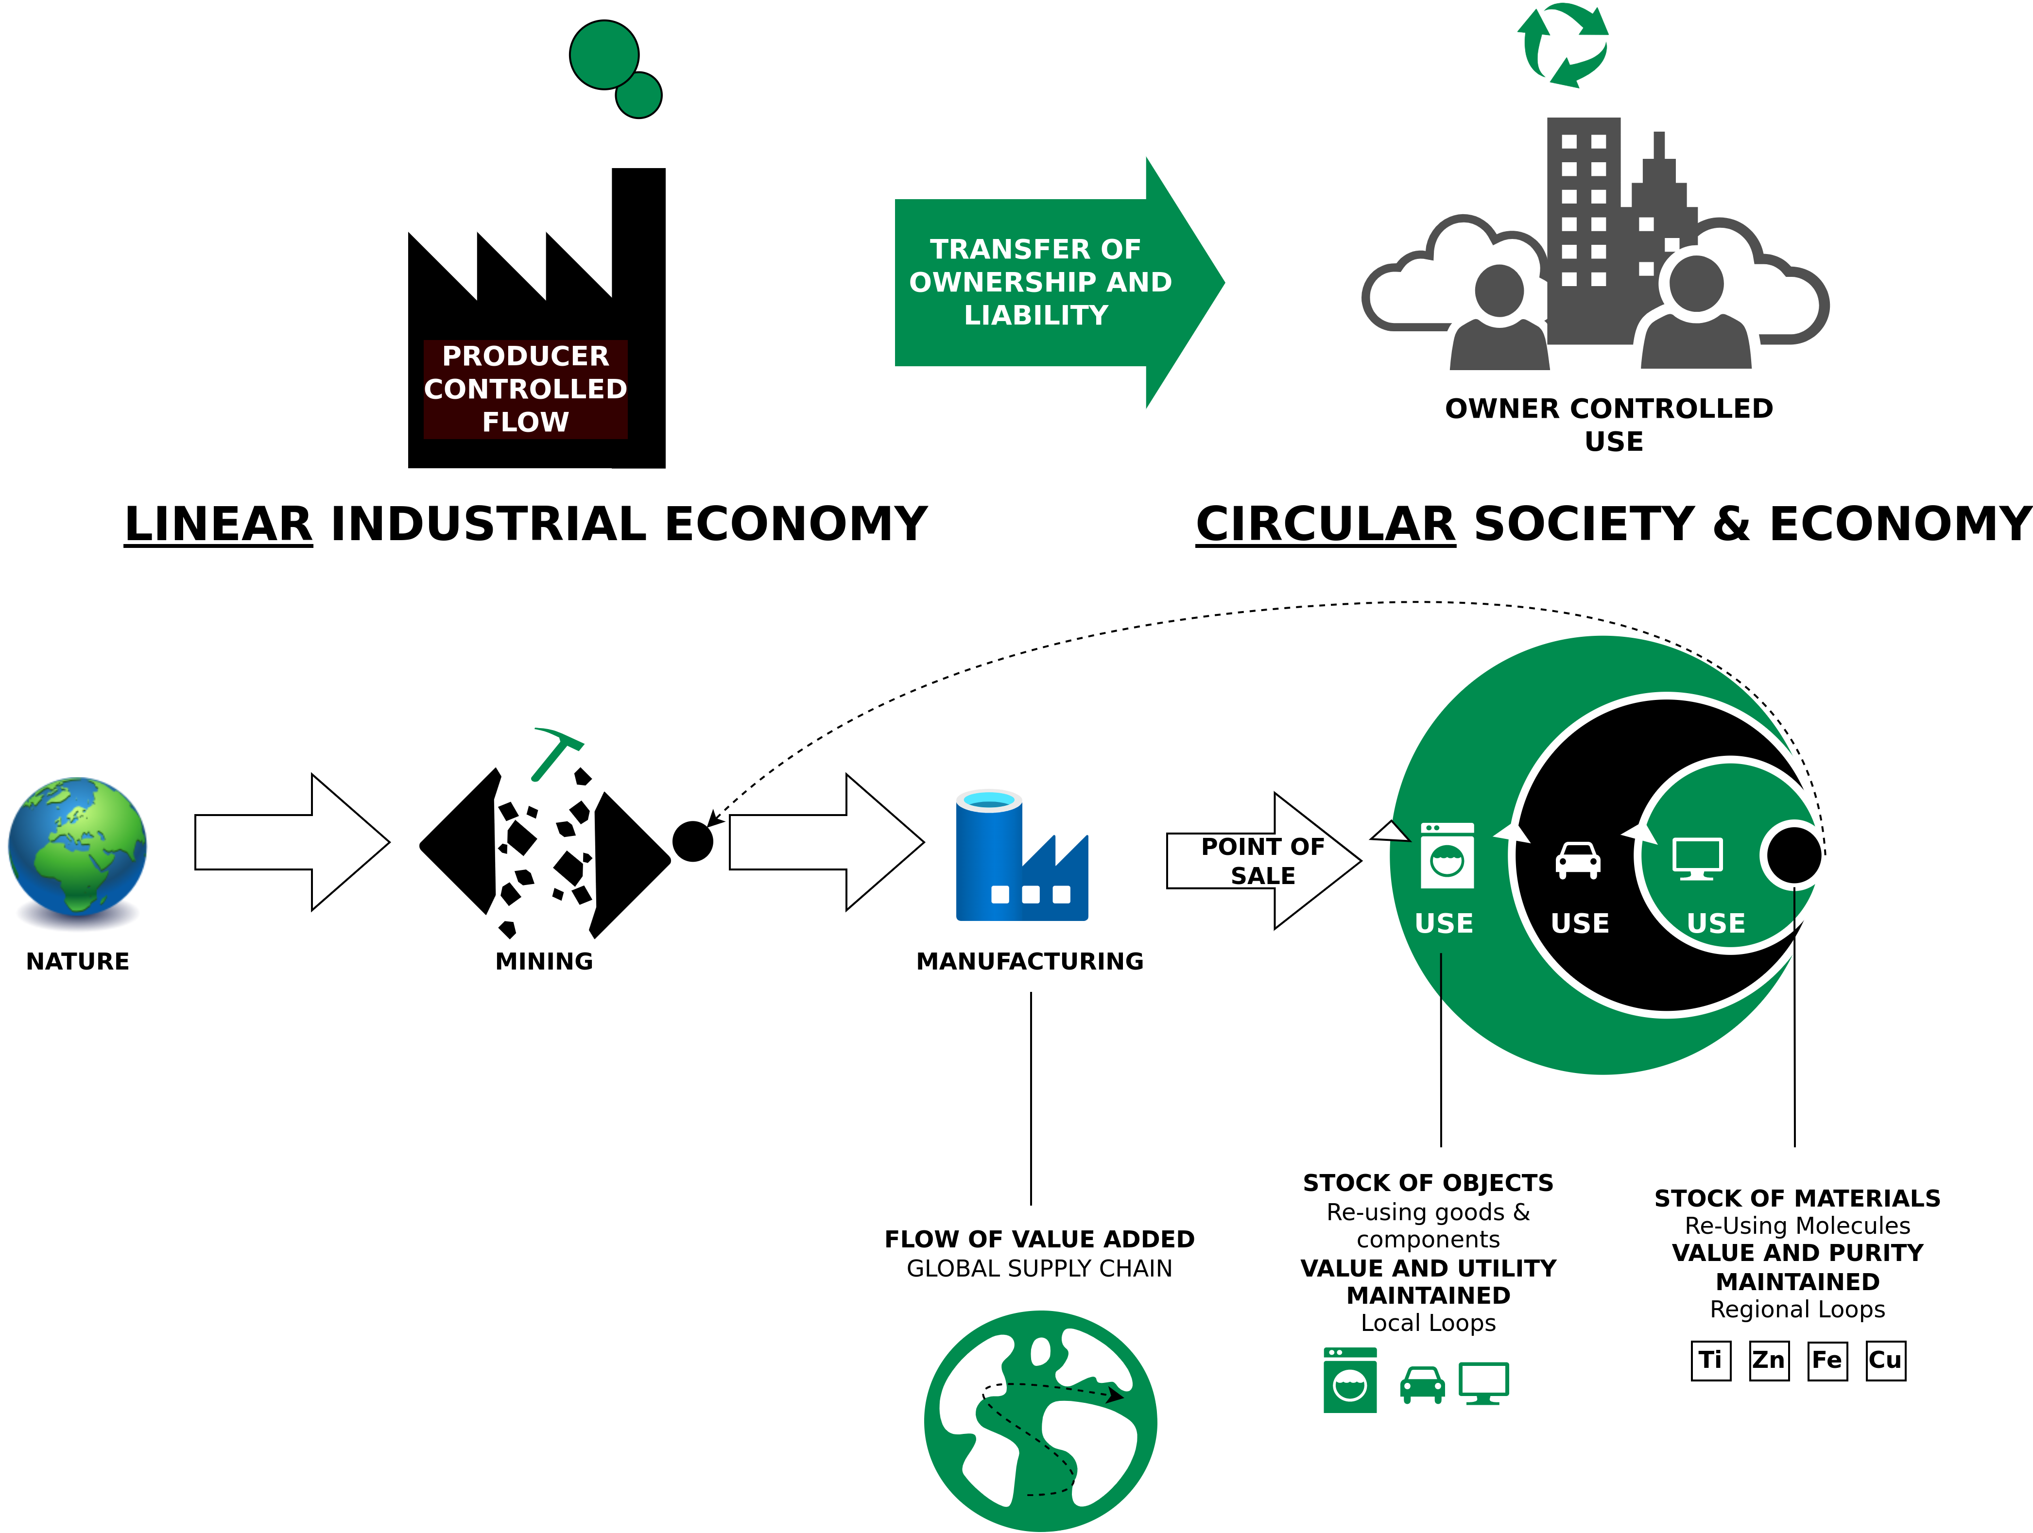
Circular Economy
Characteristics
Image adapted from: Walter R. Stahel (2019) – The Circular Economy: A User’s Guide.

Slide 28
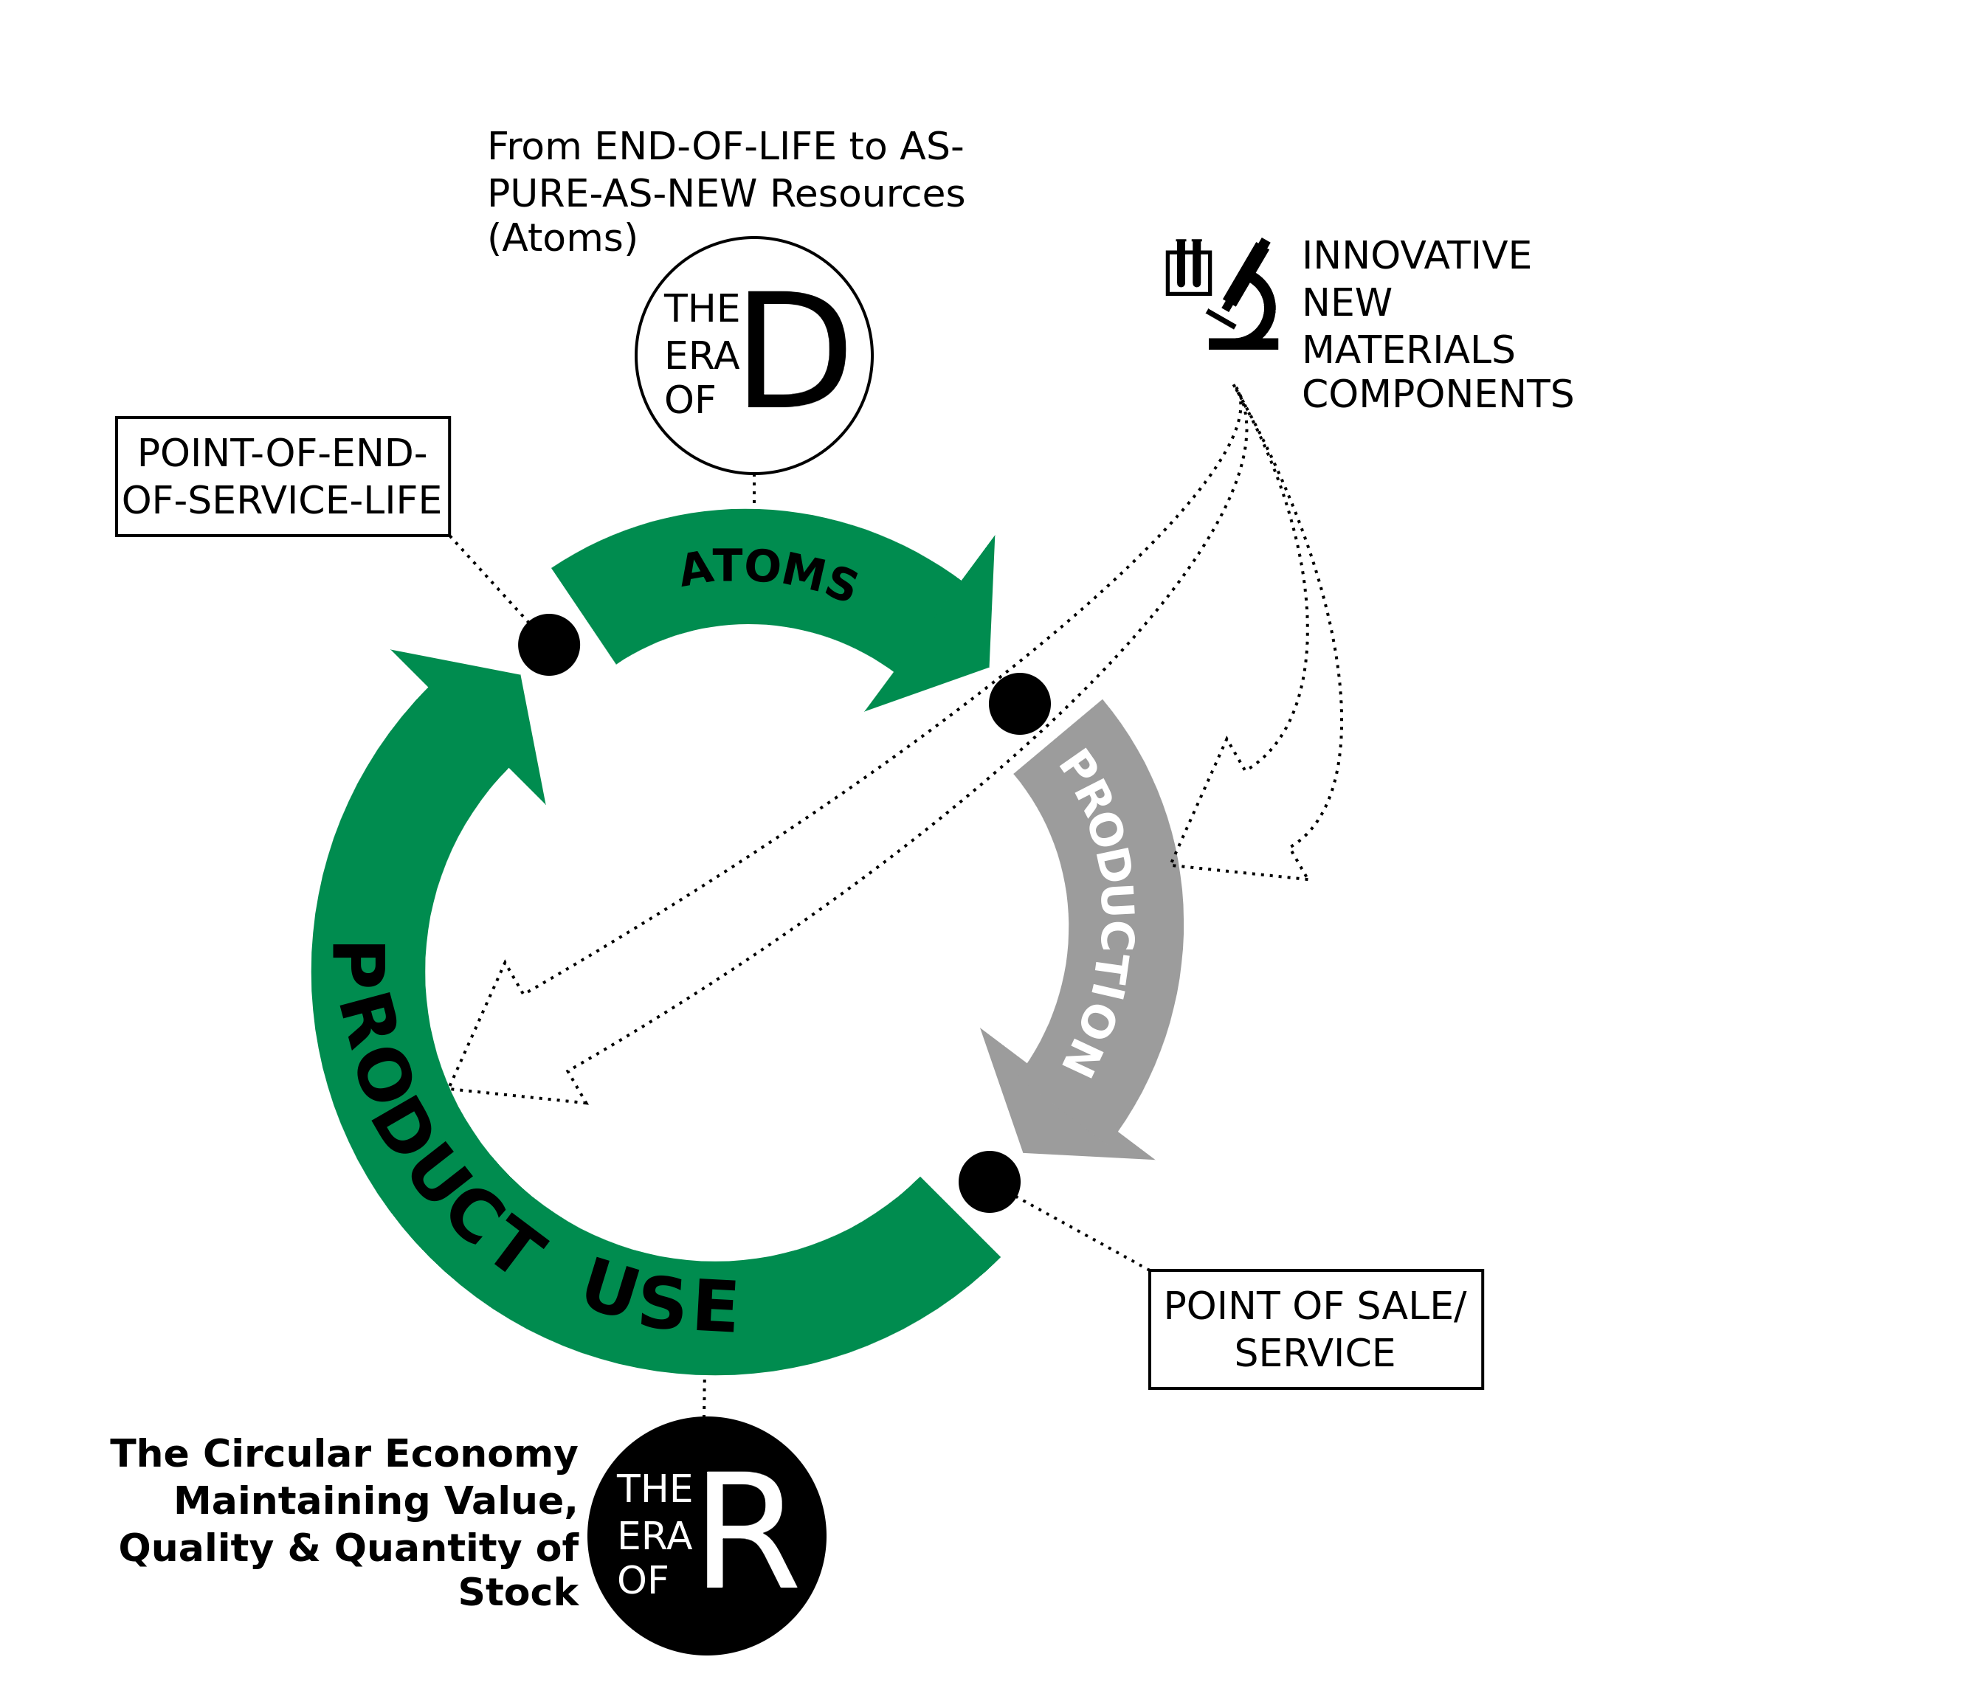
Circular Economy
The Era of R
Techno-commercial strategies to keep goods and components at highest value level through:
Reuse
Repair
Remarket
Remanufacture
Re-refine
Reprogramme goods
Image adapted from Walter R. Stahel (2019) – The Circular Economy: A User’s Guide.

Slide 29
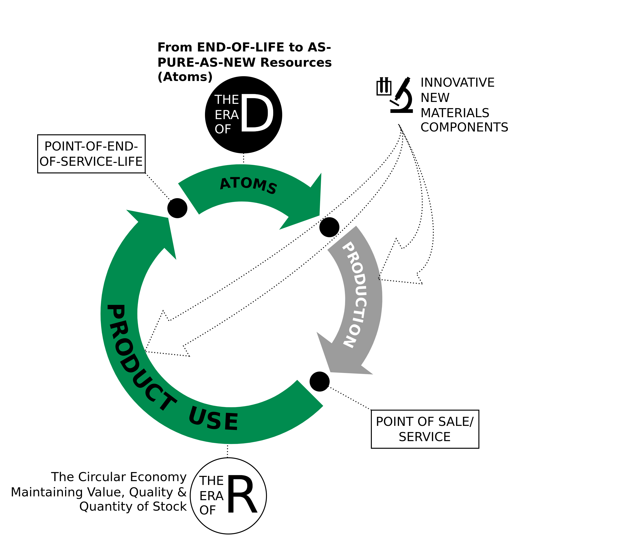
Circular Economy
The Era of D
Technologies and actions to recover atoms and molecules at highest quality (purity and value) level as pure as virgin:
De-polymerise
De-alloy
De-laminate
De-vulcanise
De-coat materials
De-construct high-rise buildings and major infrastructure
Image adapted from Walter R. Stahel (2019) – The Circular Economy: A User’s Guide.

Slide 30
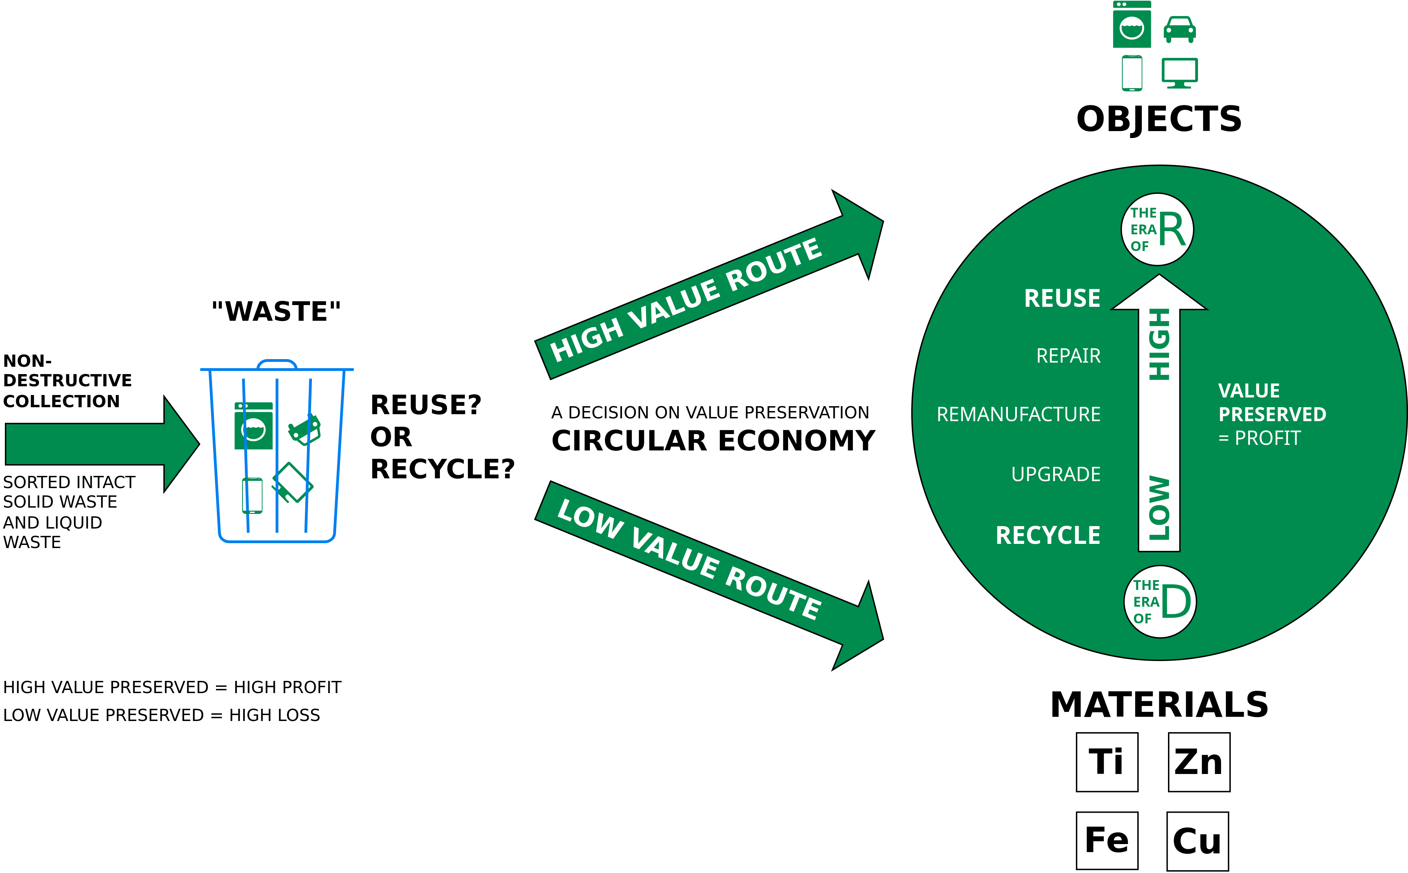
Circular Economy
End-of-Life – Reuse or Recycle?
Image adapted from Walter R. Stahel (2019) – The Circular Economy: A User’s Guide.

Slide 31
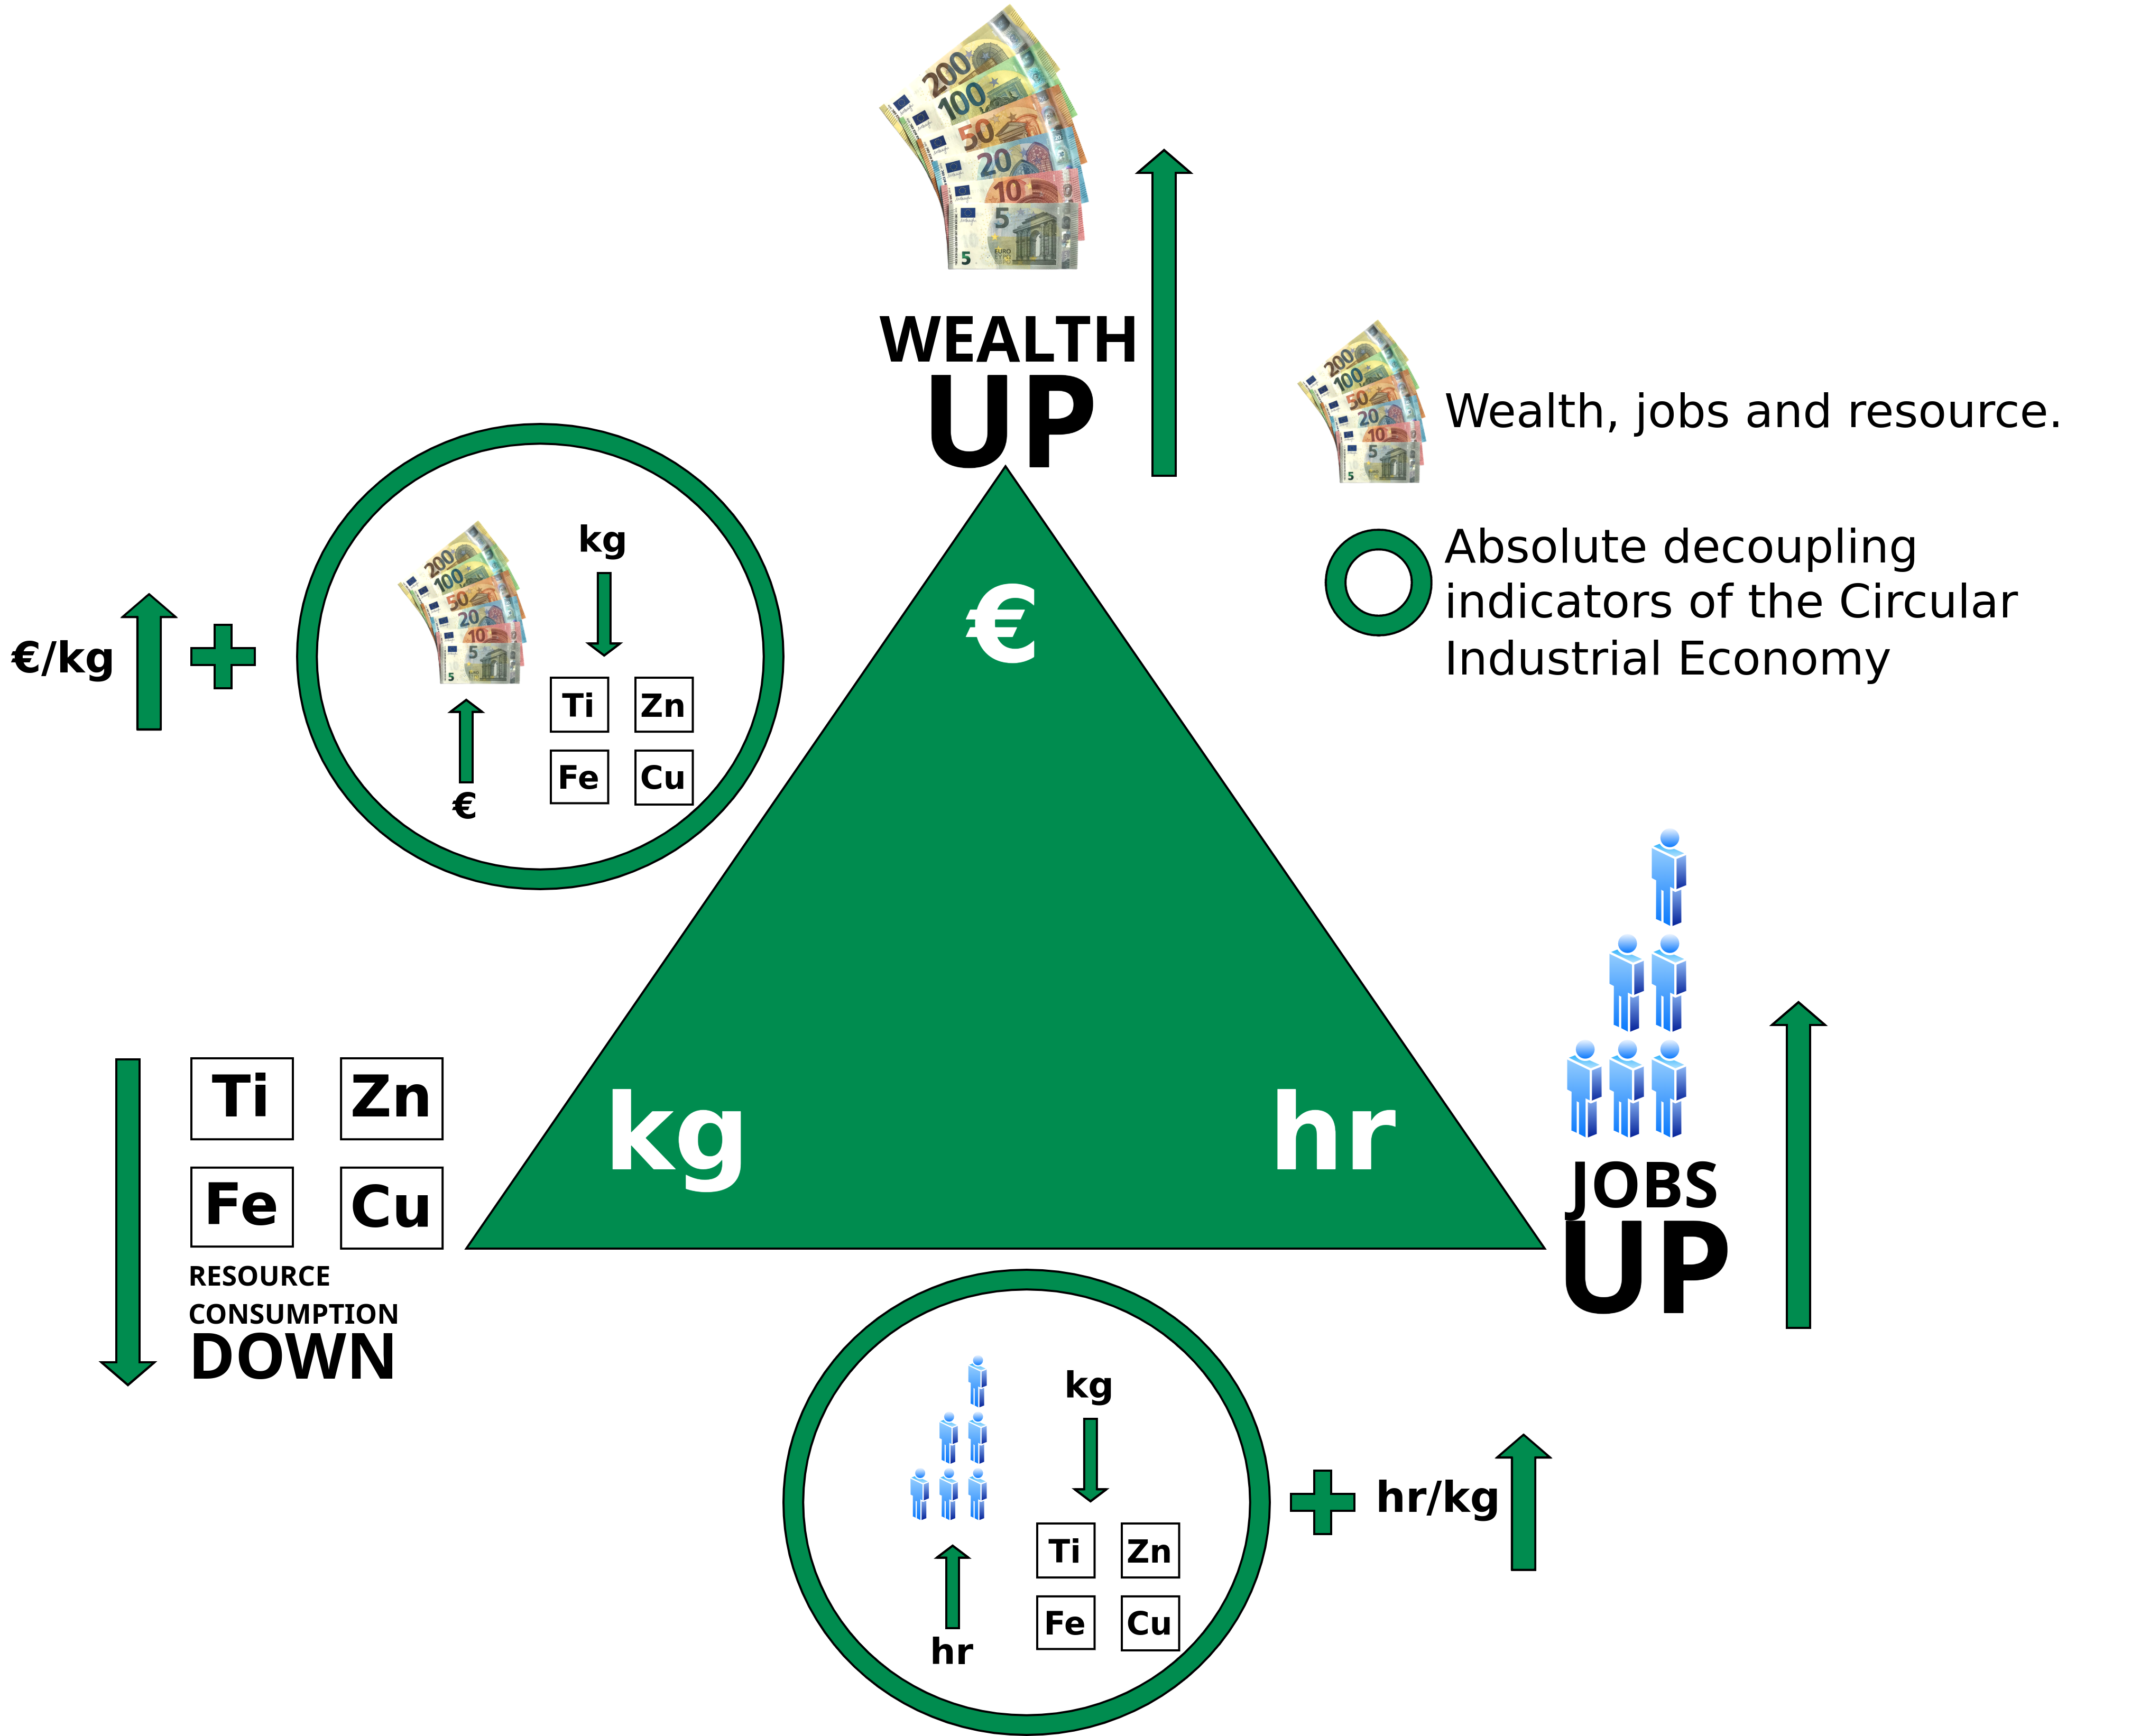
Circular Economy
More Wealth/Jobs From Less Resource Consumption
Linear Economy: Low hr/kg (labor input per weight) ratios, coherent with mass production in highly mechanized processes, and low to medium €/kg (value per weight) ratios, in a range from basic materials like cement to smart goods like USB memory sticks
Circular Economy: Higher hr/kg and €/kg ratios for reuse, remanufacture and selling performance (goods as a service), in a group with new technologies, such as life sciences and nanotechnologies, which by nature produce dematerialized objects.
Image adapted from Walter R. Stahel (2019) – The Circular Economy: A User’s Guide.

Slide 32
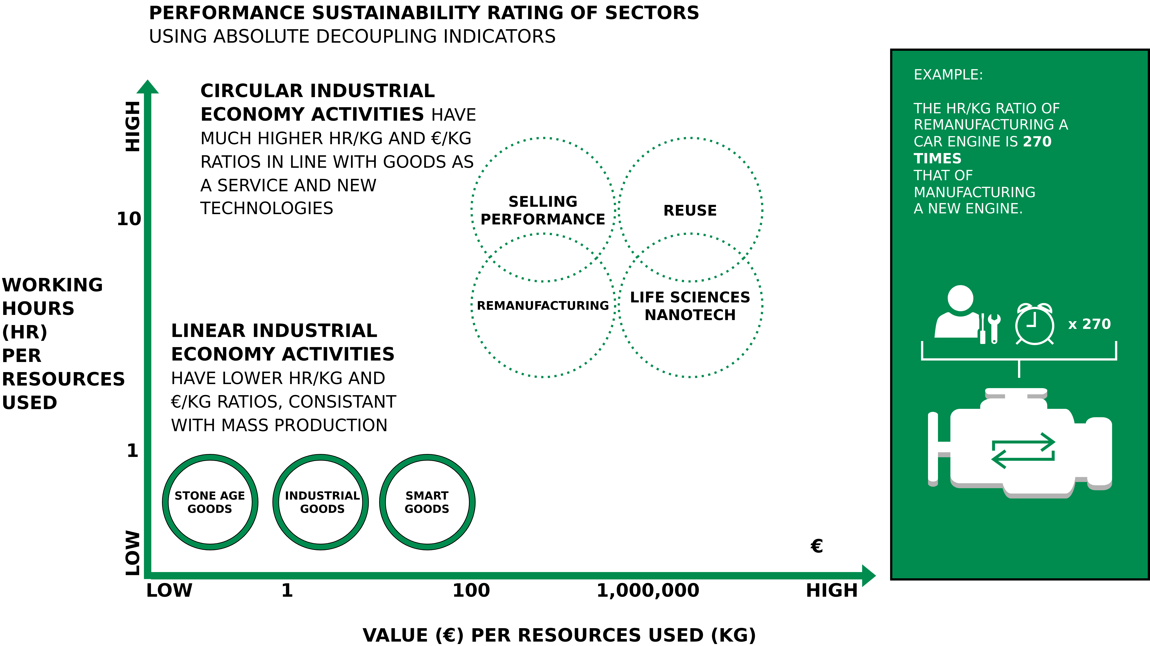
Circular Economy
New Engine vs. Remanufacturing A Car Engine
Image adapted from Walter R. Stahel (2019) – The Circular Economy: A User’s Guide.

Slide 33
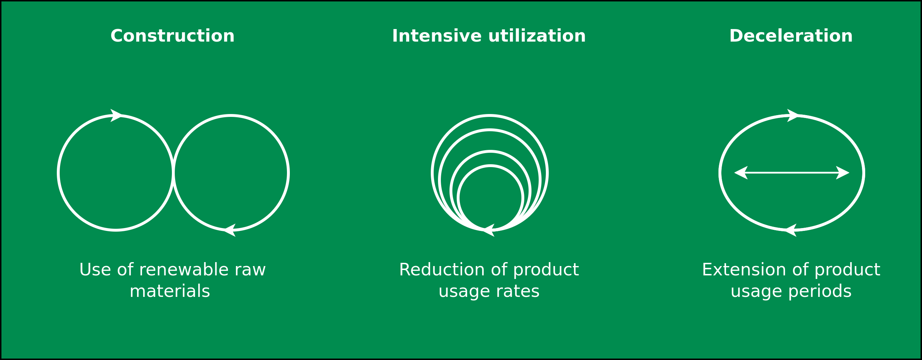
Circular Economy
Business Model Characteristics
Image adapted from: M. Jaeger-Erben, F. Hofmann (2019) – Kreislaufwirtschaft - Ein Ausweg aus der sozial-ökologischen Krise? – Link.

Slide 34
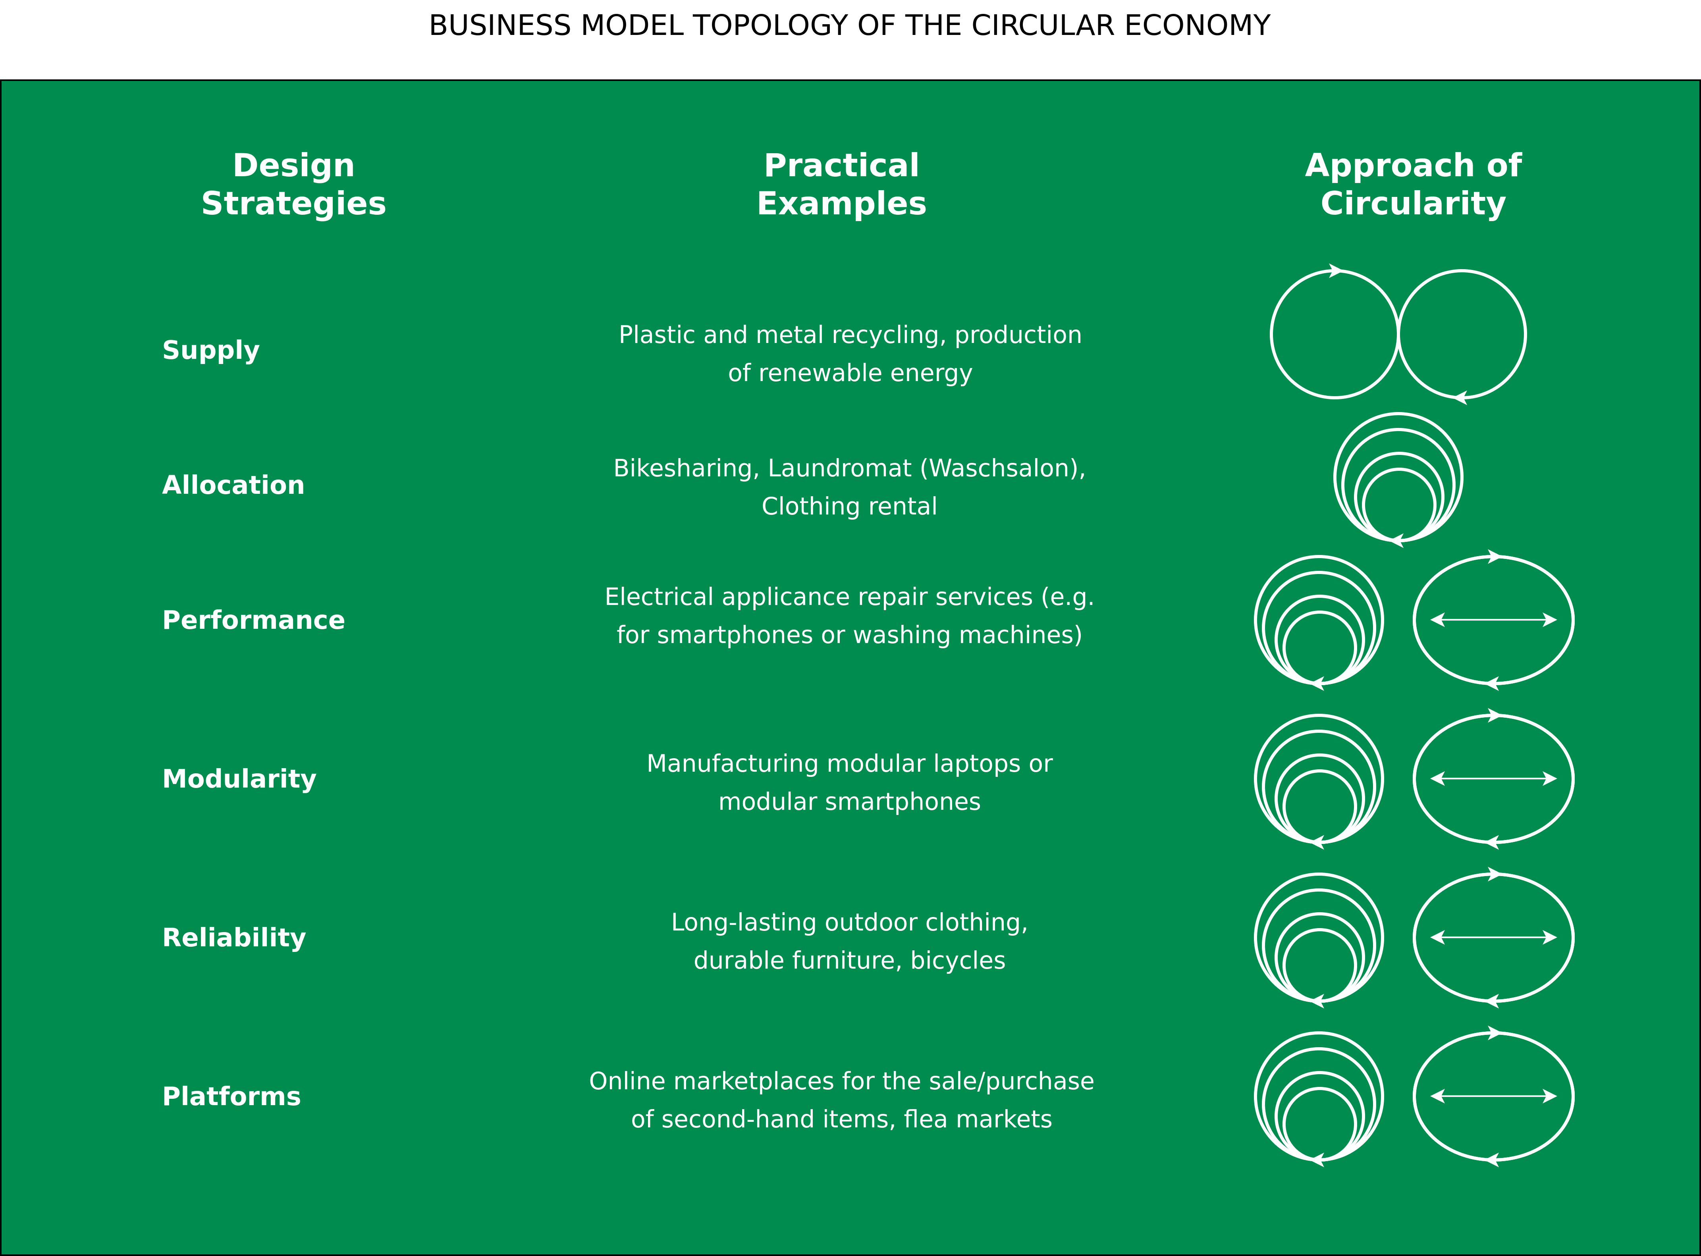
Circular Economy
Image adapted from: M. Jaeger-Erben, F. Hofmann (2019) – Kreislaufwirtschaft - Ein Ausweg aus der sozial-ökologischen Krise? – Link.

Slide 35
Performance Economy

Slide 36

Performance Economy
Image adapted from Walter R. Stahel (2019) – The Circular Economy: A User’s Guide.

Slide 37
Performance Economy – Definition
„The Performance Economy sells results instead of objects. Its economic actors may be manufacturers of durable objects or fleet managers operating them. In both cases, they sell the use of these objects as a service over the longest possible period of time and maximize their profits by exploiting both efficiency and sufficiency solutions. “
Walter R. Stahel (2019) – The Circular Economy: A User’s Guide.

Slide 38
Performance Economy – Most sustainable CE business model?
Stahel argues:
“The Performance Economy of selling goods and molecules as a service, function guarantees or results and performance, is the most sustainable business model of the circular industrial economy because by internalising the costs of product liability, of risk and waste, it offers manufacturers a strong financial incentive to prevent losses and waste.”
Walter R. Stahel (2019) – The Circular Economy: A User’s Guide.

Slide 39
Performance Economy – Most sustainable CE business model?
Stahel argues:
“The Performance Economy of selling goods and molecules as a service, function guarantees or results and performance, is the most sustainable business model of the circular industrial economy because by internalising the costs of product liability, of risk and waste, it offers manufacturers a strong financial incentive to prevent losses and waste.”
“It maximises the profit potential by exploiting sufficiency, efficiency and systems solutions.”
Walter R. Stahel (2019) – The Circular Economy: A User’s Guide.

Slide 40
Performance Economy – Most sustainable CE business model?
Stahel argues:
“The Performance Economy of selling goods and molecules as a service, function guarantees or results and performance, is the most sustainable business model of the circular industrial economy because by internalising the costs of product liability, of risk and waste, it offers manufacturers a strong financial incentive to prevent losses and waste.”
“It maximises the profit potential by exploiting sufficiency, efficiency and systems solutions.”
“In addition, by maintaining the ownership of objects and embodied resources, it creates long-term corporate and national resource security at low cost.”
Walter R. Stahel (2019) – The Circular Economy: A User’s Guide.

Slide 41
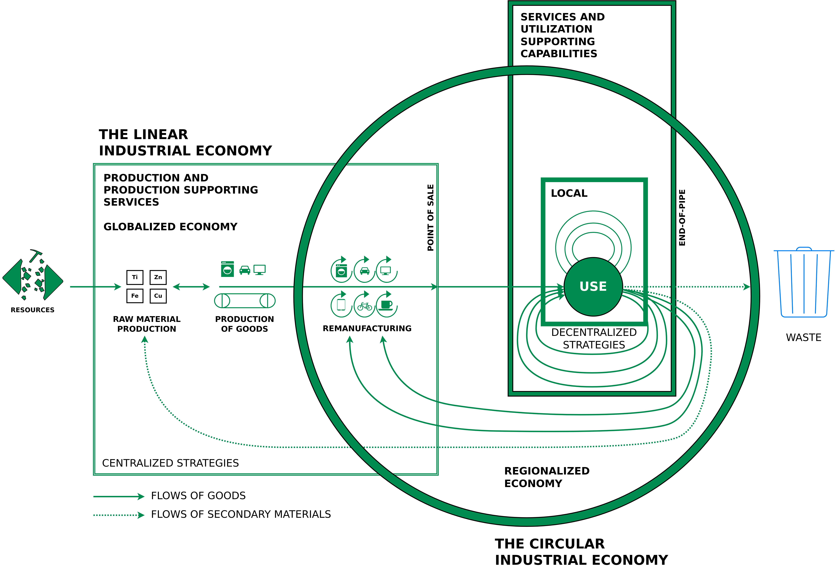
Situating the LIE, the CIE and the PE
Circle: Managing the utilisation or use phase of stocks of manufactured objects and their components, by maintaining the value and quality of infrastructure, buildings, investment goods, equipment and durable consumer goods in a local or regional economy
Small square: Local use-focused PE
Big square: Flows of used materials returning to the raw material producer to recover molecules and atoms in a globalised economy
Walter R. Stahel (2019) – The Circular Economy: A User’s Guide.

Slide 42
Situating the LIE, the CIE and the PE
Circle: Managing the utilisation or use phase of stocks of manufactured objects and their components, by maintaining the value and quality of infrastructure, buildings, investment goods, equipment and durable consumer goods in a local or regional economy
Small square: Local use-focused PE
Big square: Flows of used materials returning to the raw material producer to recover molecules and atoms in a globalised economy
Walter R. Stahel (2019) – The Circular Economy: A User’s Guide.

Slide 43
Situating the LIE, the CIE and the PE
Circle: Managing the utilisation or use phase of stocks of manufactured objects and their components, by maintaining the value and quality of infrastructure, buildings, investment goods, equipment and durable consumer goods in a local or regional economy
Small square: Local use-focused PE
Big square: Flows of used materials returning to the raw material producer to recover molecules and atoms in a globalised economy
Walter R. Stahel (2019) – The Circular Economy: A User’s Guide.

Slide 44
Conclusion

Slide 45
Conclusion
Linear Economy (LE) → “Take – make – dispose”
Circular Economy (CE) → Maintain value and utility as high as possible for as long as possible
Performance Economy → Sell results instead of objects

Slide 46
Additional Resources
Walter R. Stahel (2019) – The Circular Economy: A User's Guide
Website of the Ellen MacArthur Foundation – Link

Slide 47
Questions?

